Slide 1
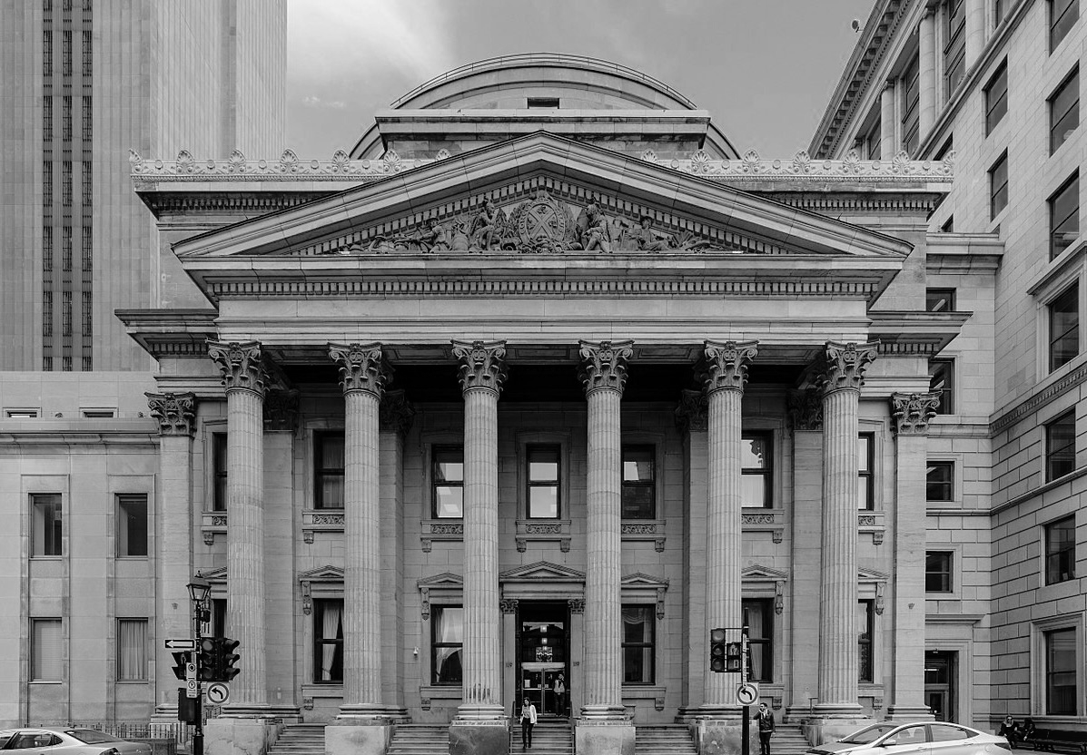
Who are the best prospects for our term deposit marketing campaign?
Vanessa Okosun and Flore Zadji
MS in Business Analytics

Slide 2
ABOUT MERCER BANK AND THE PRODUCT
01
BUSINESS OBJECTIVE
PROJECT OVERVIEW
02
OUR APPROACH
FINAL VARIABLES
TABLE OF CONTENTS
03
MODEL PERFORMANCE
MODEL SELECTION
04
INSIGHTS
RECOMMENDATION
APPENDIX
05

Slide 3

MERCERBANK & IT’S PRODUCTS
MercerBank offers many services such as personalized financial services tailored to your needs.
You can get concierge-like service and assistance in a wide array of financial matters ranging from deposit accounts, wire transfers and currency exchanges to investments, wealth planning and elder care.
Also known as a fixed-term investment. It is the depositing of money into an account at a financial institution that offers a guaranteed return.

Slide 4
PROBLEM & OBJECTIVE
Problem:
The bank has a product that is underperforming and not bringing in enough revenue.
Objective:
To find the best candidate/prospect for the term deposit
What is the best channel to reach out to the prospects?
Is phone marketing the best channel for this marketing campaign?

Slide 5
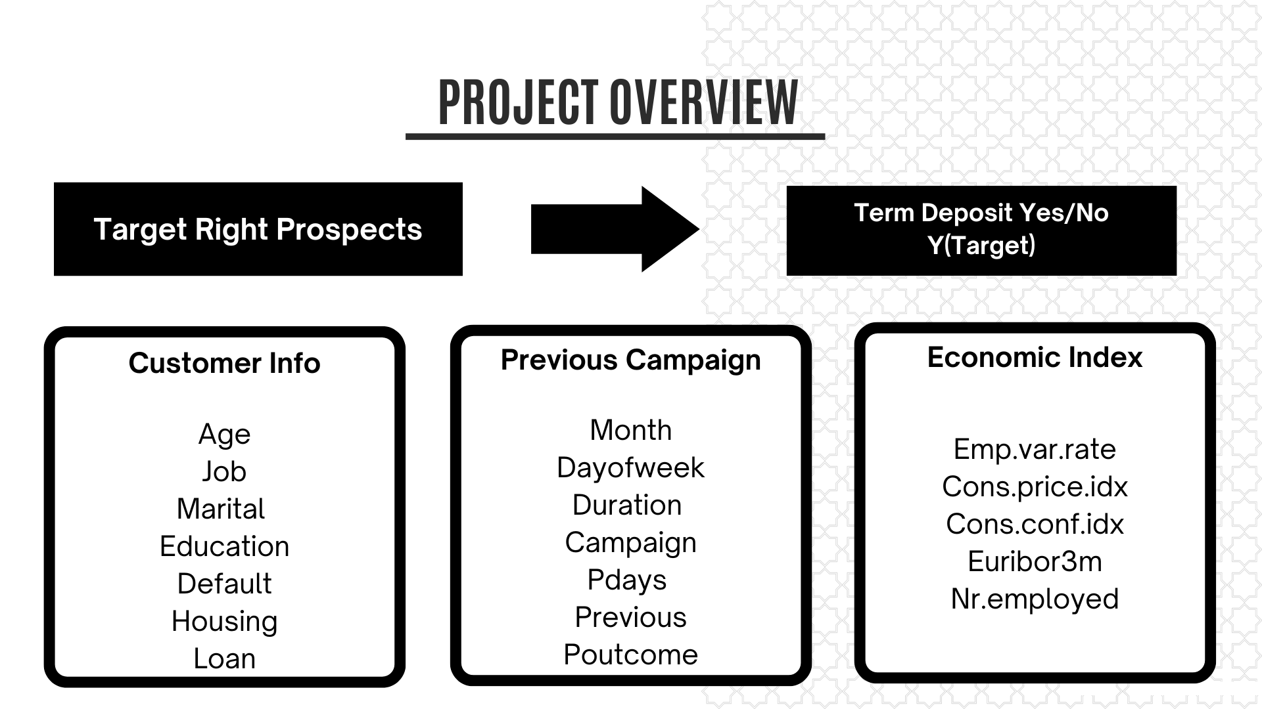

Slide 6
Analyzed dataset to select only variables that are important to our analysis and to detect anomalies in the variables.
Select type of model to be used based defined objective
OUR APPROACH
Create an oversample data to counter bias towards ‘no’ in our dataset and run each model with both imbalance and balance dataset
Compare the performance of each model and Select the model that helps answer our objective.

Slide 7
Y
POUTCOME
DEFAULT
JOB
MARTIAL
FINAL VARIABLES
CONTACT
LOAN
DAY_OF_WEEK
HOUSING
EDUCATION
MONTH
Notes:
Suggestion: Remove ‘1’ associated to variable name
List all the variable in one column and add maybe 3 bar charts on the side( that will cover the descriptive part)

Slide 8
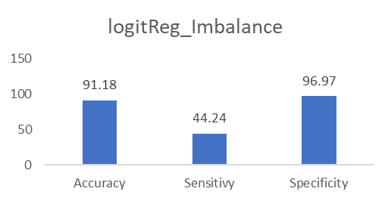
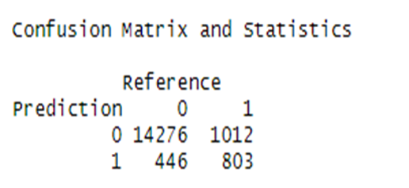
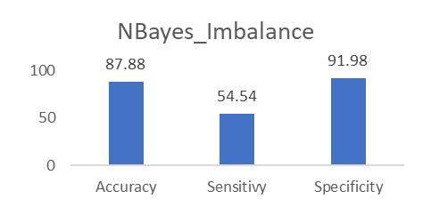
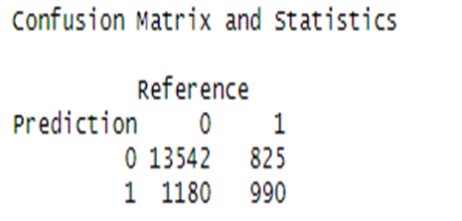
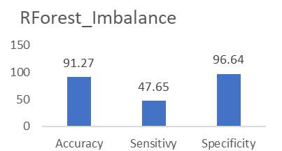
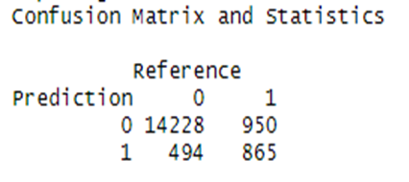
MODEL PERFORMANCE
Respondent No: 89%
Respondent Yes: 11%
Model 1
Model 2
Model 2
Model 3

Slide 9
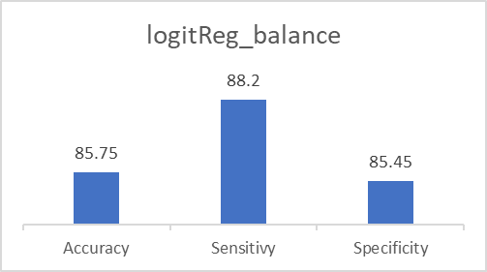
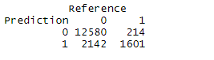
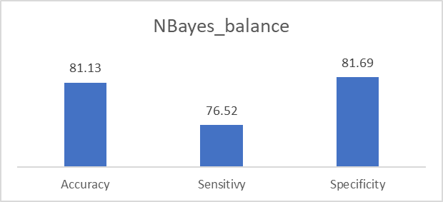
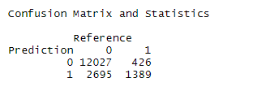
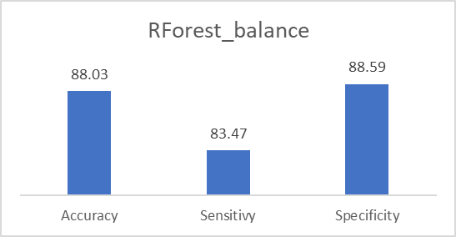
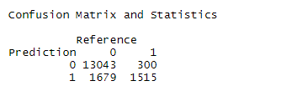
MODEL PERFORMANCE
Respondent No: 51%
Respondent Yes: 49%
Model 1
Model 2
Model 3
Venus has a beautiful name and is the second planet from the Sun. It’s terribly hot—even hotter than Mercury—and its atmosphere is extremely poisonous. It’s the second-brightest natural object in the night sky after the Moon
Notes:
FIX SIZES

Slide 10

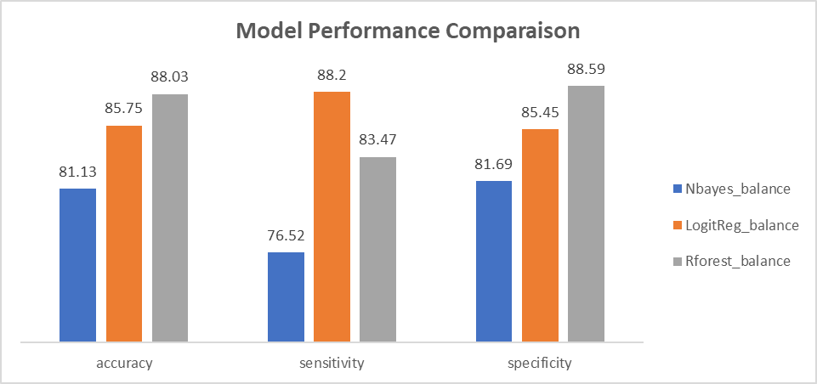
MODEL SELECTION
Venus has a beautiful name and is the second planet from the Sun. It’s terribly hot—even hotter than Mercury—and its atmosphere is extremely poisonous. It’s the second-brightest natural object in the night sky after the Moon

Slide 11

INSIGHTS
Dominance of ‘no’ approved for term deposit created an imbalance in the dataset with bias towards ‘no’
College degree retirees and students tend to favor term deposit
Telephone outreach did not yield good result
Monday and Friday were not good days to reach out to potential prospects
Campaign launch in 2nd and 3rd quarter have better return than other quarters
Campaign results decreased as the year ends out
Notes:
Maybe be add stock picture of light bulb Or something similar related to Insight so I the slide is not just plain

Slide 12

RECOMMENDATION
Retirees and college students are more inclined for this type of product. The business may need other communication channel other than landline to reach out to those prospects.
For students social medias channel or online campaign might be more effective in reaching out to that demography
For retirees Ads on Tv channels used by retirees, senior citizen clubs,
Timing of the campaign matters. Study shows that campaign launched between second and third quarter yield better return than other quarters
Notes:
Same here. Let add stock picture related to recommendation

Slide 13

THANK YOU!

Slide 14
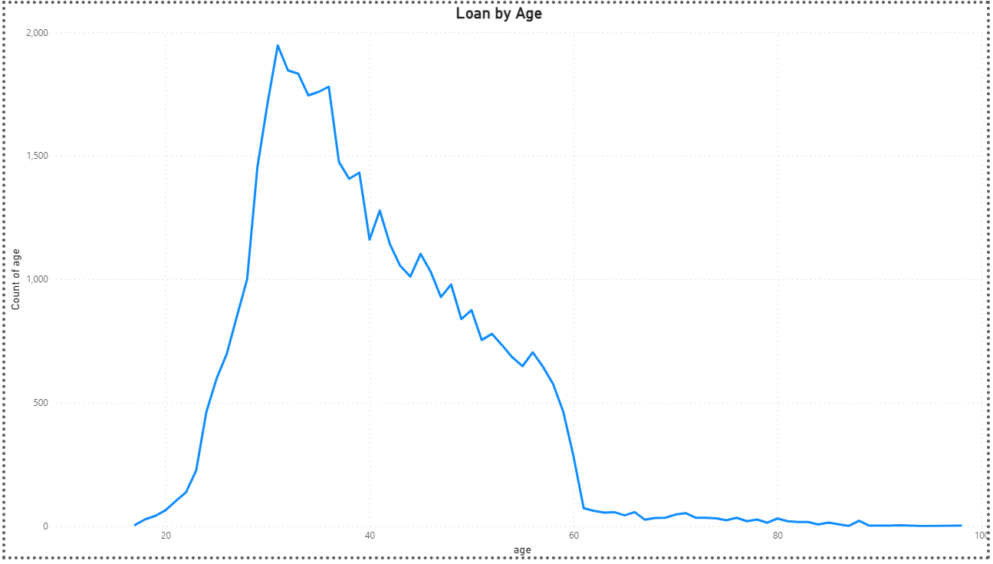
APPENDIX 1
Most of the clients in this marketing campaign are between the ages mid 20s and early 60s.

Slide 15
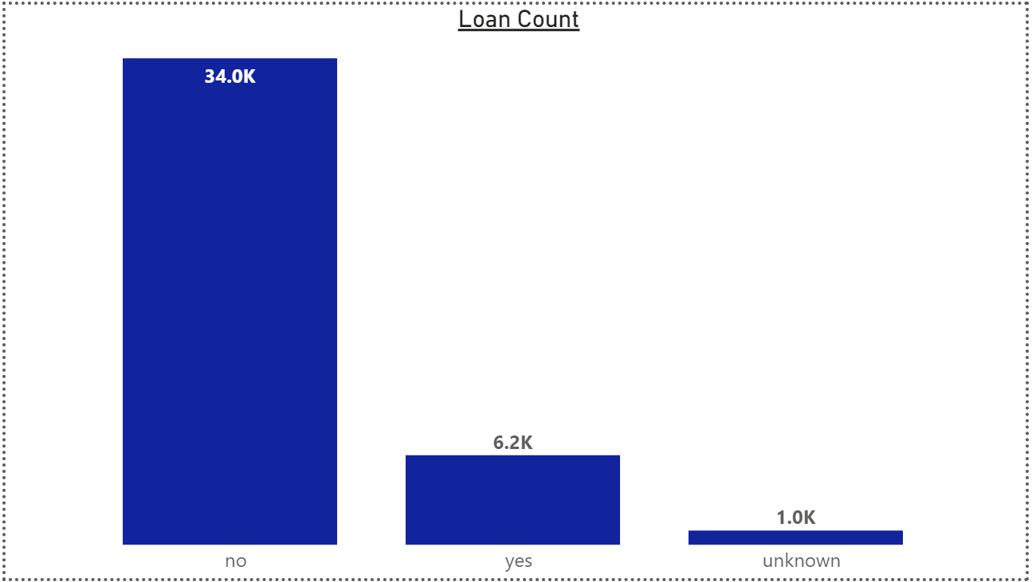
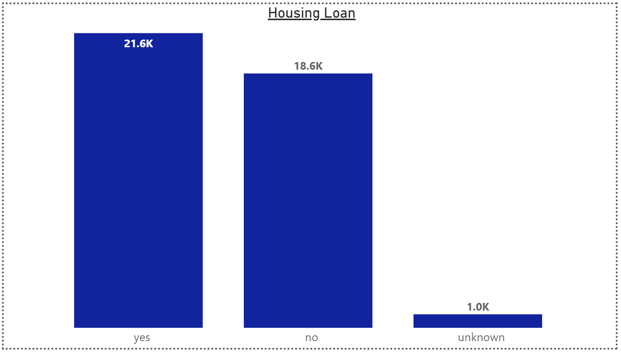
APPENDIX 2
Out of the data of the clients, only 6.2K have a personal loan either though MercerBank or another insistution.
Out of the data of the clients, only 21.6K have a housing loan either though MercerBank or another insistution.

Slide 16
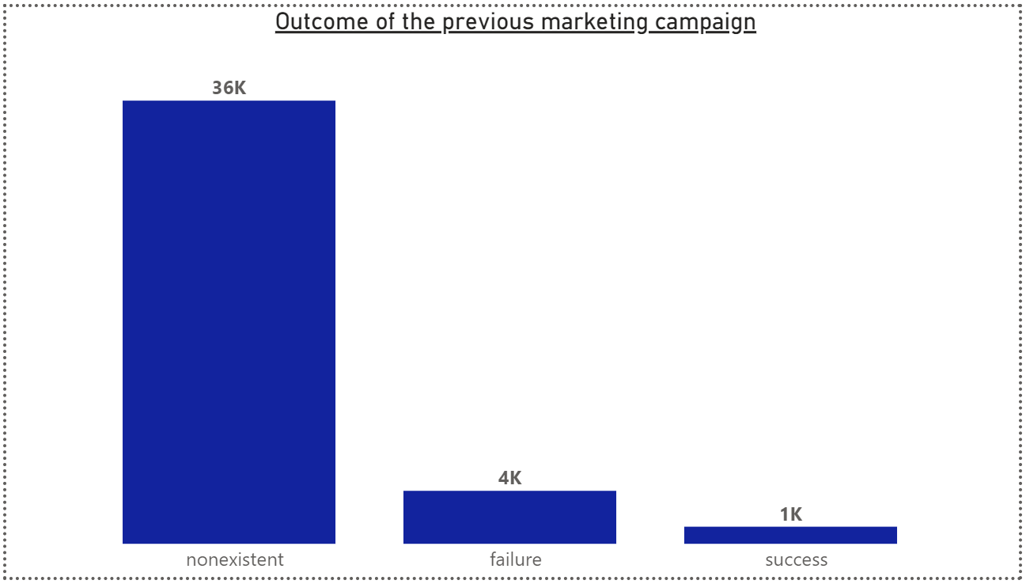
APPENDIX 3
Out of the data of the clients, only 6.2K have a personal loan either though MercerBank or another insistution.

Slide 17
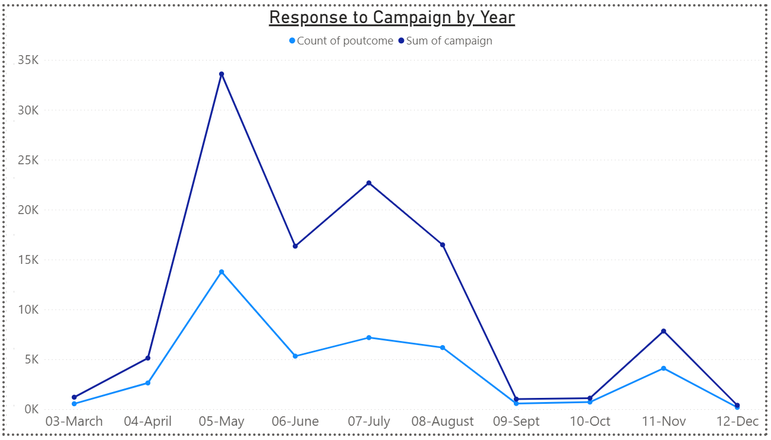
APPENDIX 4
Response to campaign by year.

Slide 18
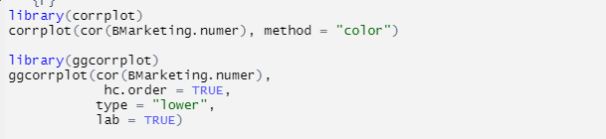
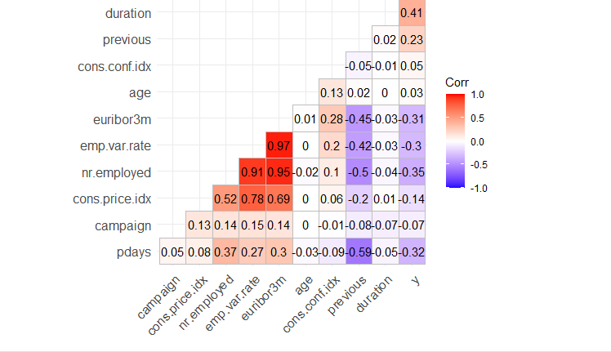
APPENDIX 5
Correlation analysis that show degree of correlation between variables

Slide 19
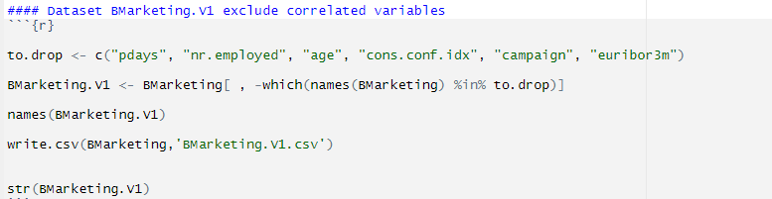
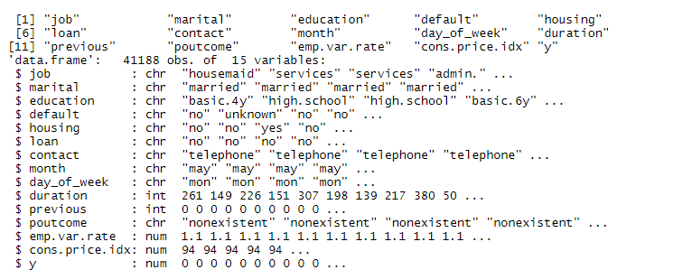
APPENDIX 6
Reduce dimension of the dataset by removing insignificant variables

Slide 20
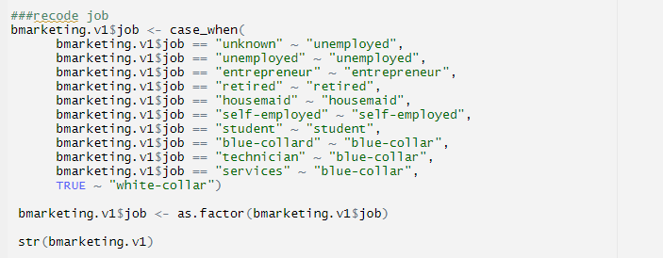
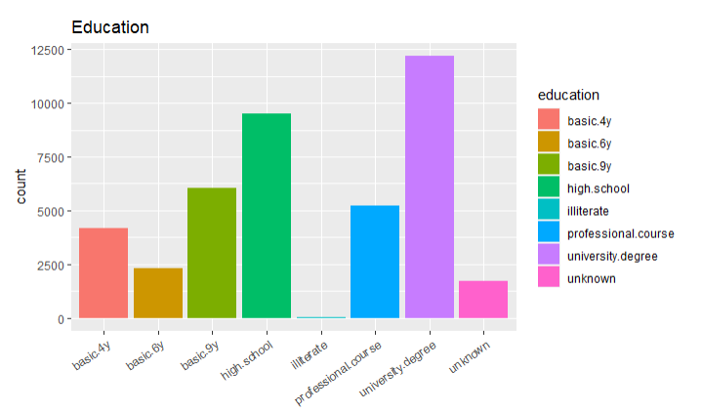
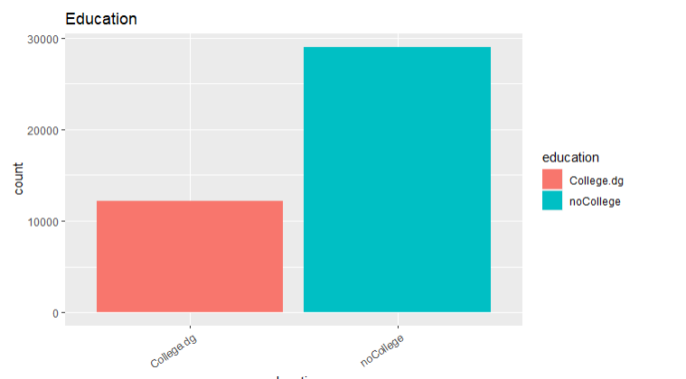
APPENDIX 7

Slide 21
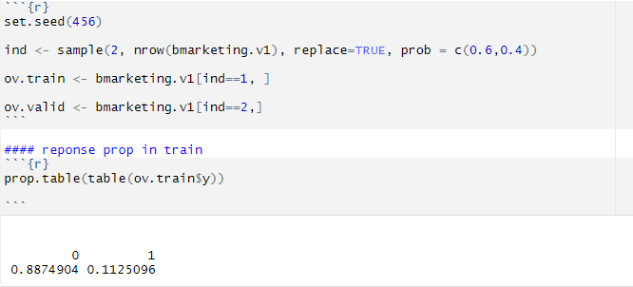
APPENDIX 8
Partition dataset into training and validation.
Dominance of ‘no’ 89% compared to 11% of ‘yes’

Slide 22
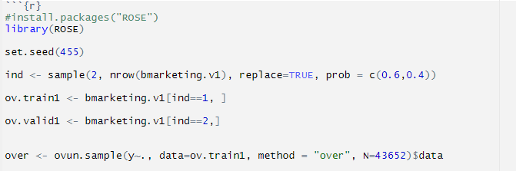
APPENDIX 9
Created oversample dataset using ROSE library

Slide 23
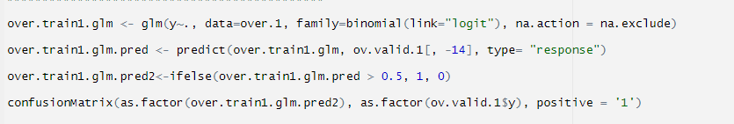
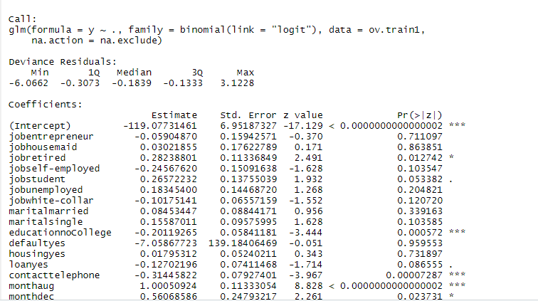
APPENDIX 10
Logistic regression results

Slide 24
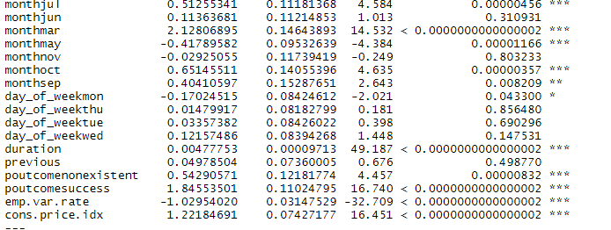
APPENDIX 11
Logistic regression results

Slide 25
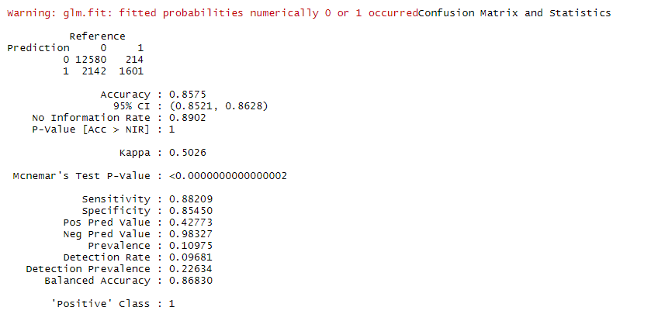
APPENDIX 12
Logistic regression confusion matrix for balance dataset

Slide 26
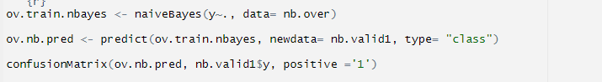
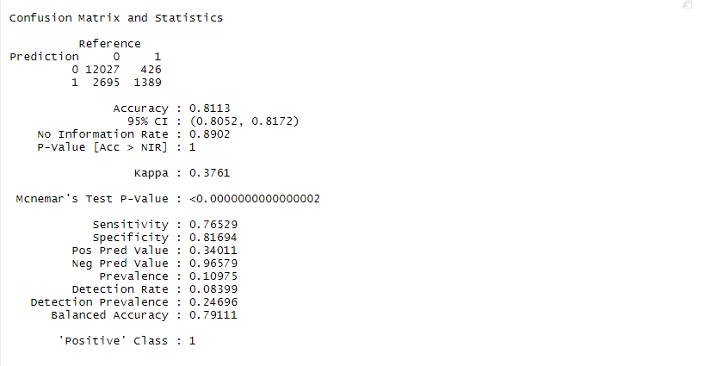
APPENDIX 13
Naive Bayes confusion matrix with balance dataset

Slide 27
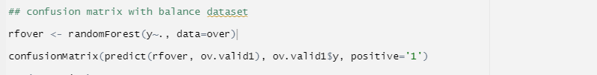
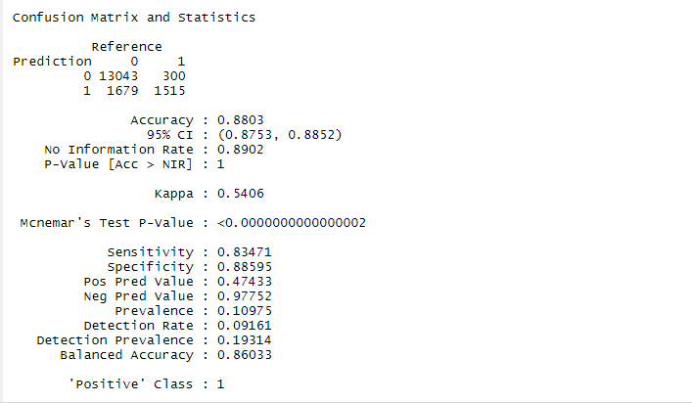
APPENDIX 14

Slide 28
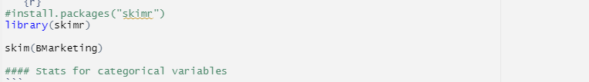
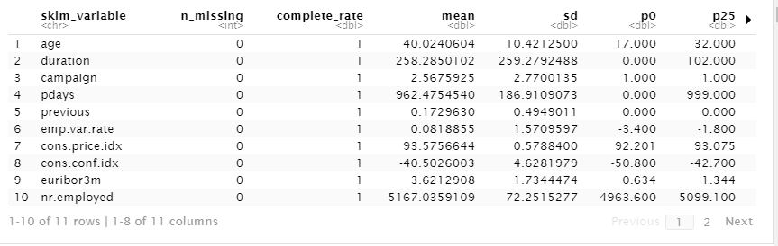
APPENDIX 15

Slide 29
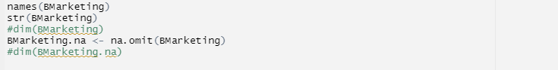
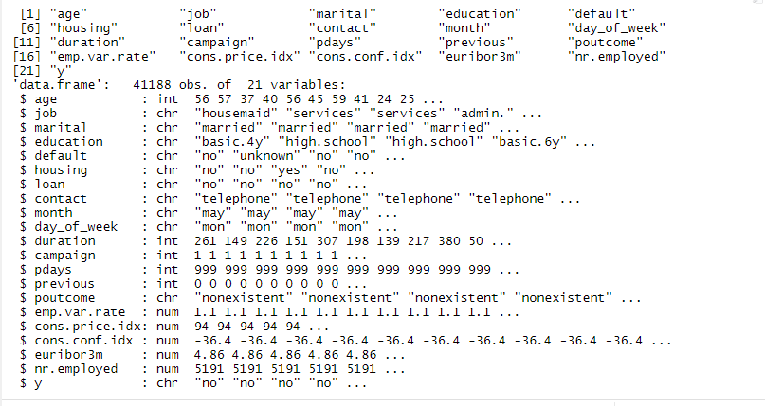
APPENDIX 16

